Slide 1

Lending Application Result Predictions November 8, 2019
banknxt.com

Slide 2
APPENDIX
3 | INTRODUCTION
4 | DATA
5 | ANALYTIC APPROACH
6 | BASELINE
7 | SUPERVISED LEARNING RESULTS
8 | XGBOOST – CLOSER LOOK
9 | CONCLUSION

Slide 3

INTRODUCTION
Objective: Using machine learning models to predict whether a loan application will be approved or declined based on limited number of features.

Slide 4
DATA
Lending Club Accepted & Declined Data from 2007 to 2018
Data is sourced from Kaggle website
5% of total data is used due to computation limitation. Stratified random sampling based on Loan_Amount is used for reduction.
Machine Learning Algorithm
Loan Amount
Debt to Income Ratio
Region
Employment Length
Risk Score
Approved/ Declined Label
Notes:
State is categorized into regions based on the Bureau of Economic Analysis region split as each separate state is not expected to have significant influence on the prediction
Employment_Length is converted from string to int through removing the word “year” from the end, and also any length <1 is relabeled as 0 & 10+ is relabeled as 10.
Risk_Score is normalized because Reject data post November 5, 2013 uses Vantage score and FICO before the date. Approved data all use FICO score (mean of primary and secondary applicant when there is secondary applicant).
Approved is labeled as 1 and Rejected is labeled as 0.
Any Loan_Amount more than $40k is removed as anything higher is considered non-standard loan and are treated as outliers.
Any loan with NaN data sets are removed as the data set is large and this will not affect model result.
Note that Debt_To_Income_Ratio in the approved data set is the mean between primary applicant and secondary applicant. Reject dataset did not include secondary applicant info.
Applications Debt_To_Income_Ratio of greater than 0.5 have been removed as these are deemed to be outliers.
Data are randomly shuffled to get more accurate cross validation results using StratifiedKFold (random state 42).

Slide 5
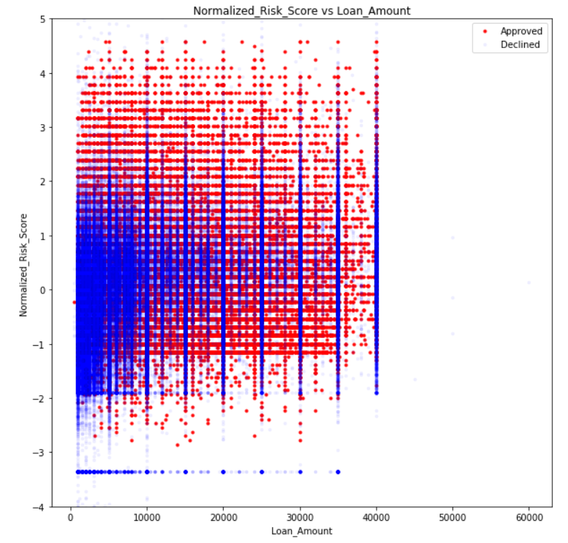
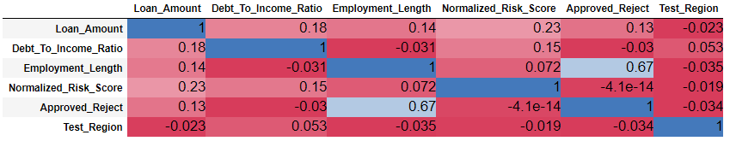
ANALYTIC APPROACH
Exploratory Data Analysis
Baseline Prediction
Logistic Regression
Random Forest
XGBoost
Initial exploratory data analysis is done to note of any easy to observe patterns in the overall data and to help determine baseline model.
Set up Baseline Prediction using non-Machine Learning methods.
Apply Classification Supervised Learning to the data in order to see if better results can be achieved.
Notes:
Baseline is for comparison purpose
Correlation table and loan amount & DTI ratio graphs are examples of exploratory data analysis.
High correlation for Employment Length which is inline with results seen later with MS methods.
Graph on the right shows how approved loans are more concentrated on the lower Loan Amount.

Slide 6
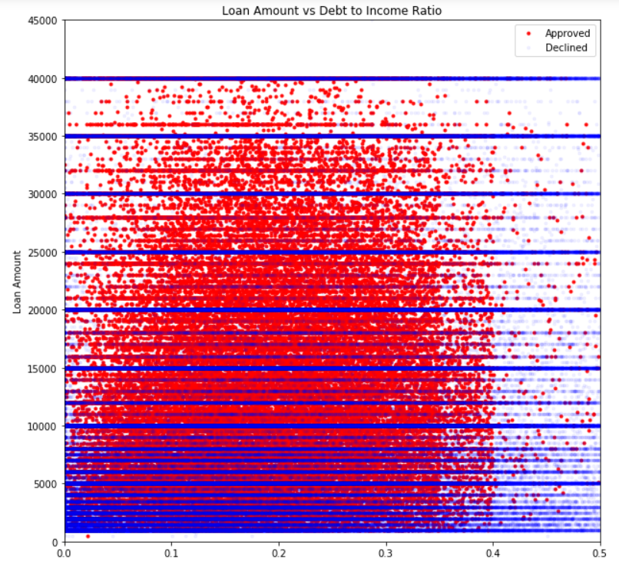
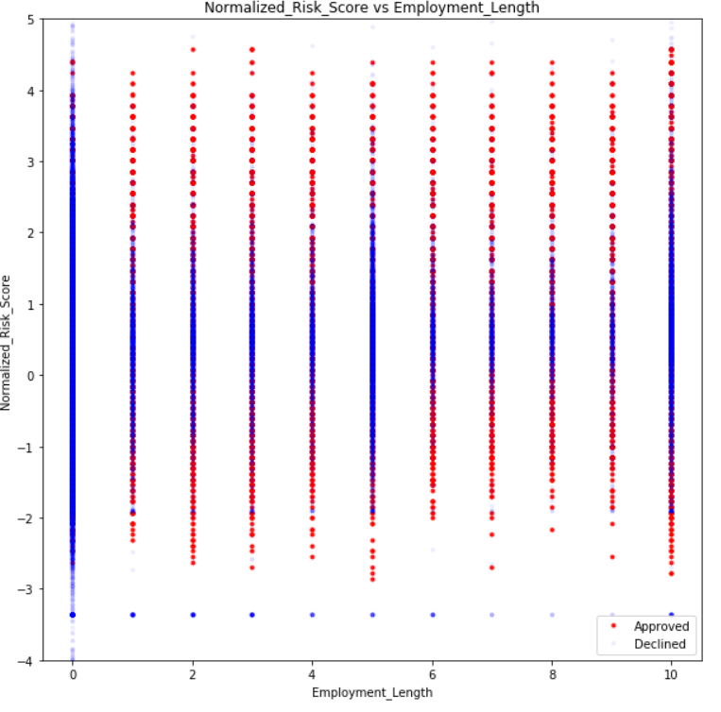
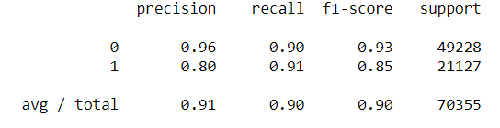

BASELINE
>= 40% Debt to Income Ratio
OR
< 1 year Employment Length (0 in the Graph on the Right)
REJECT
All other applications
APPROVE
Notes:
0 column is predominantly rejected
0.4 DTI is the stated number on Lending Club website
There is a $40k cap for most loans but we have filtered out higher amounts as we treat those as outliers
Correlation table demonstrates that Employment Length is the most important feature
1 is approved
0 is declined

Slide 7







SUPERVISED LEARNING RESULTS
XGBoost has the highest AUC Score demonstrating it had the best performance.
Random Forest’s results are very close to that of XGBoost while Logistic Regression actually performed worse than Baseline.
XGBoost
#2 Random Forest
#3 Logistic Regression
Notes:
Looking at the confusion matrix, XGBoost has significantly outperformed Baseline in every quadrant

Slide 8
XGBOOST – CLOSER LOOK
Employment_Length has an unusually large influence relative to the other features.
Random Forest has arrived with similar results.
This result is similar to the correlation table seen previously.
Regions were disregarded by XGBoost via getting 0% importance
Notes:
Random Forest give less importance to employment Length but give some importance to regions

Slide 9
CONCLUSION
Results are heavily dependent on Employment Length
Risk Score and Debt to Income ratio also had substantial contribution.
Due to the reliance on Employment Length non-machine learning method is also fairly accurate
However, both Random Forest and XGBoost added significantly more predictive power
With AUC score close to 99%, both RF and XGBoost can be used as a preliminary application model by LendingClub.
Additional areas of expansion would be to get more data for rejection dataset as there are very few features available relative to the approved dataset.

